Slide 1
Group 1 Feature Engineer and Machine Learning for Stock Market Analysis and Prediction
Group 1: Paul Phillips, Qi Cai, Xin Gao
GitHub at pcp0019/CSCE-5222-Group-1 (github.com)

Slide 2
Introduction
Objective: Use feature engineering and machine learning algorithms to make a program to predict stock price
Obtain data involving information on a company’s stock price
Perform feature engineering to alter and add relevant features
Perform machine learning to make predictions on stock price

Slide 3
Dataset Information
Our dataset was downloaded from Yahoo finance
Includes High, Low, Open, Close, Adj Close, Volume
Covers the time span from 2013-1-1 to 2023-11-1
Performed calculations to add extra features
Daily Value Proportion

Slide 4
Dataset Feature Engineering
Calculates H-L, high price of the day – low price of the day
Calculates O-C, opening price – closing price
Calculates Daily Value Proportion
(Daily Close Price – 25th percentile price)/(75 percentile price – 25th percentile price)

Slide 5
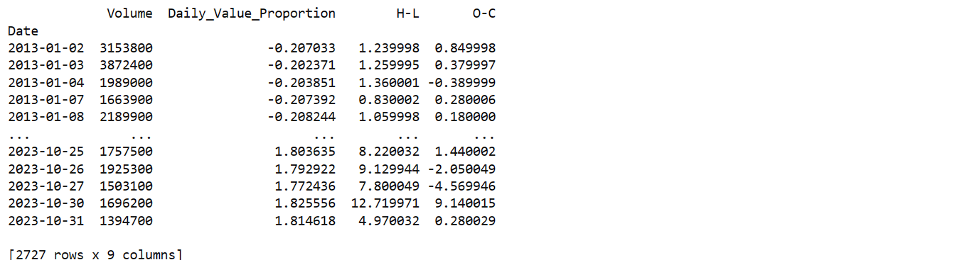
KNN Regression for Price Prediction
Adds the features to our dataset
Dropped Volume and Close/Adj Price columns
Close Price is what we are trying to predict, so it was set to y in the model
Trains a K Nearest Neighbor regression model on the new feature set
Makes predictions, and the R2 score is: 0.9998

Slide 6
Naïve Bayes for Price Prediction
Created a new feature called Rise or Fall
Represented by either a 0 or a 1
It is 1 if the price rose, and 0 if it fell from the last day
With this feature as our new target, trained and tested Naïve Bayes

Slide 7
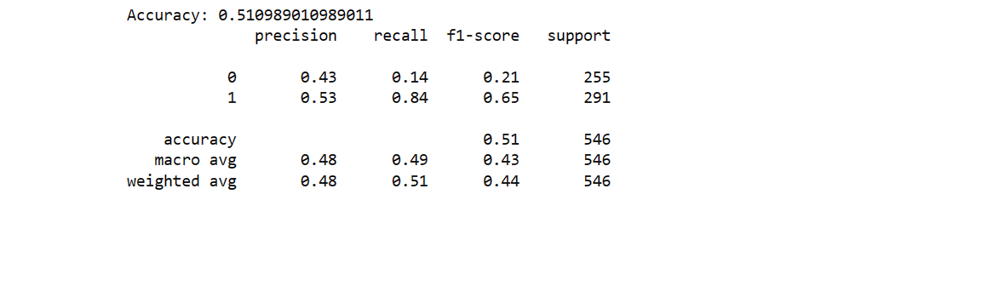
Naïve Bayes Results
Accuracy of 0.51
F1 score was 0.21 in predicting fall
F1 score was much higher, 0.65 in predicting a rise
Differences in Recall, 0.84 in rise prediction, 0.14 in fall prediction

Slide 8
Gradient Boosting Regressor
Raised the test fraction of the data to 0.3 from 0.2
Using 100 estimators
Learning rate set to 0.1
Decision tree depth set to 3

Slide 9
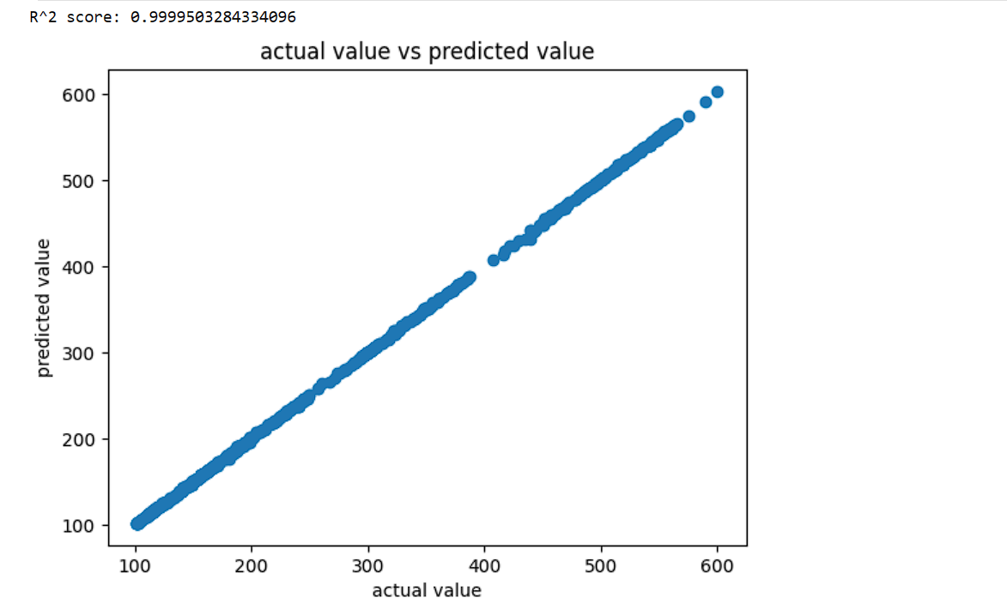
Gradient Boosting Results
R2 score was very high at 0.9999
Linear relationship
Matches very close

